Slide 1
Book Store
Class Name: PF1126
Group Name: TBN Group
Member: Tran Luu Phuc Thanh
Bui Huy Binh
Phan Thi Kim Nga

Slide 2

Objectives
The objective of the project is to develop an efficient and user-friendly software application that automates and streamlines the management of book inventory, sales transactions, and customer information for a small bookstore.
The system aims to enhance operational efficiency, improve accuracy, and provide a better customer experience.

Slide 3









Introduction to Project
Proposed System
- Manage the Store
- Create Order
The scope of the project
Make for actor:
Manager and User
Deployment Environment
Windows
Mac
Development Tools
Visual Studio Code
Draw.io Diagram
MySQL Workbench 8.0 CE

Slide 4

Introduction to Project
SYSTEM FEATURES
User Sign In
User Login
Search Books
Create Order
Show Order List
Manage Users
Manage Books

Slide 5
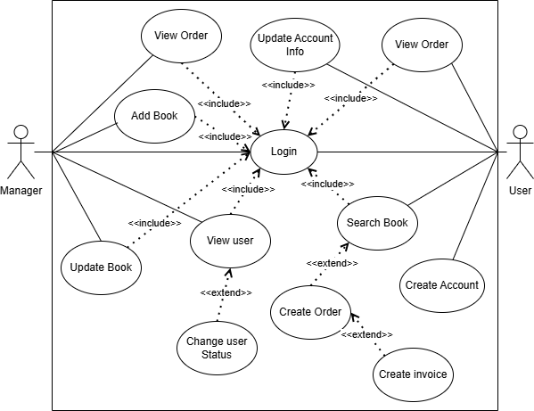
Use Case

Slide 6
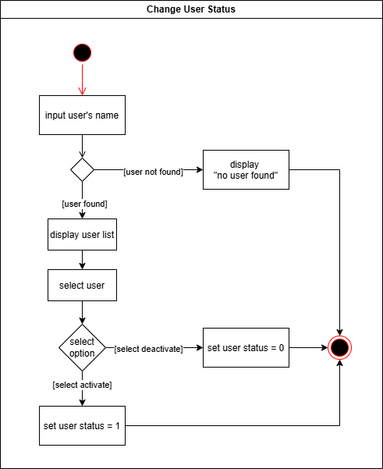
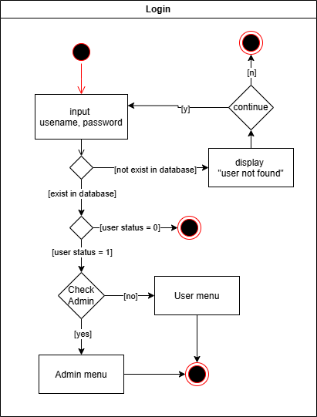
Activity Diagram

Slide 7
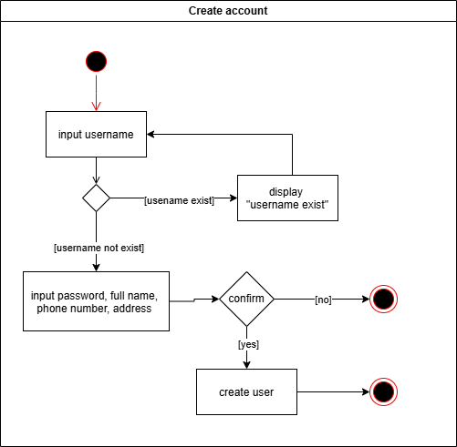
Activity Diagram

Slide 8
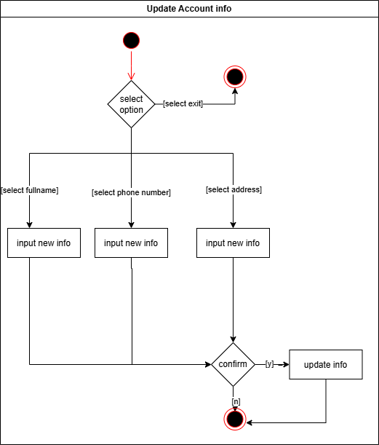
Activity Diagram

Slide 9
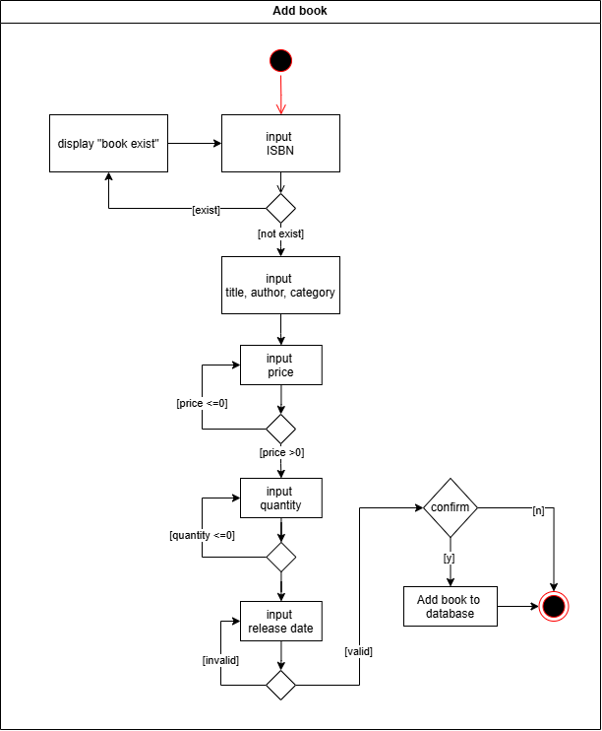
Activity Diagram

Slide 10
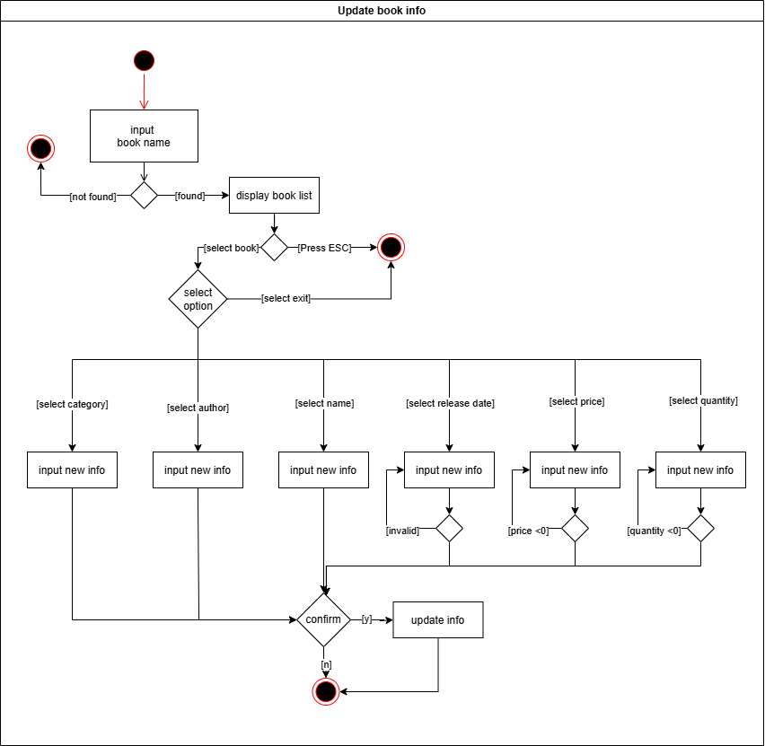
Activity Diagram

Slide 11
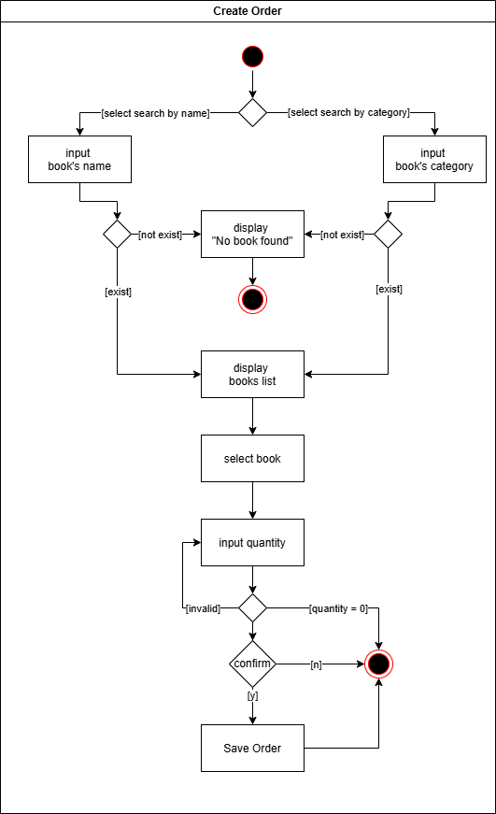
Activity Diagram

Slide 12
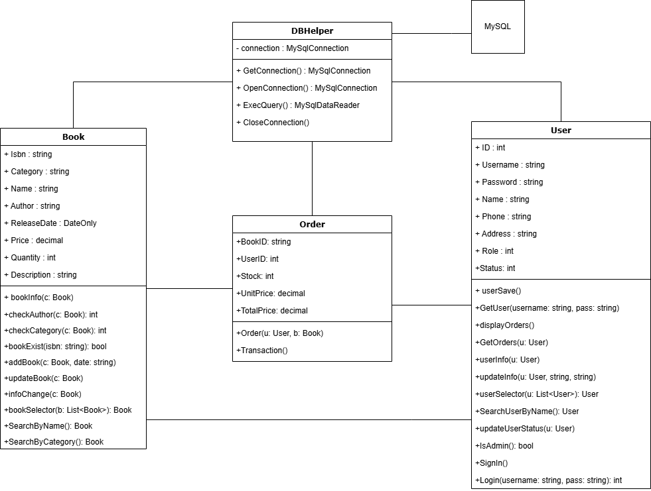
Class Diagram

Slide 13
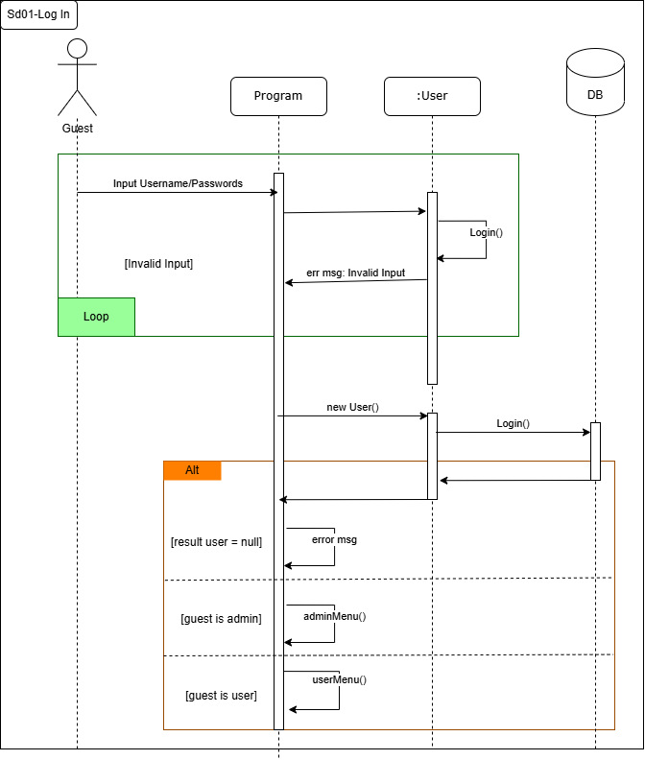
Sequence Diagram

Slide 14
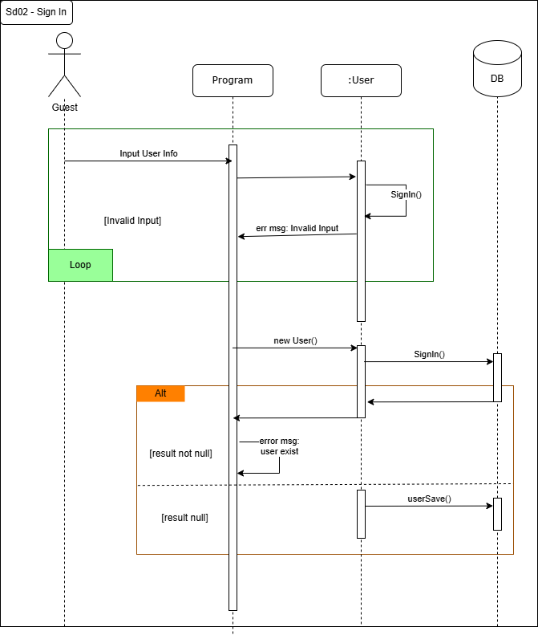
Sequence Diagram

Slide 15
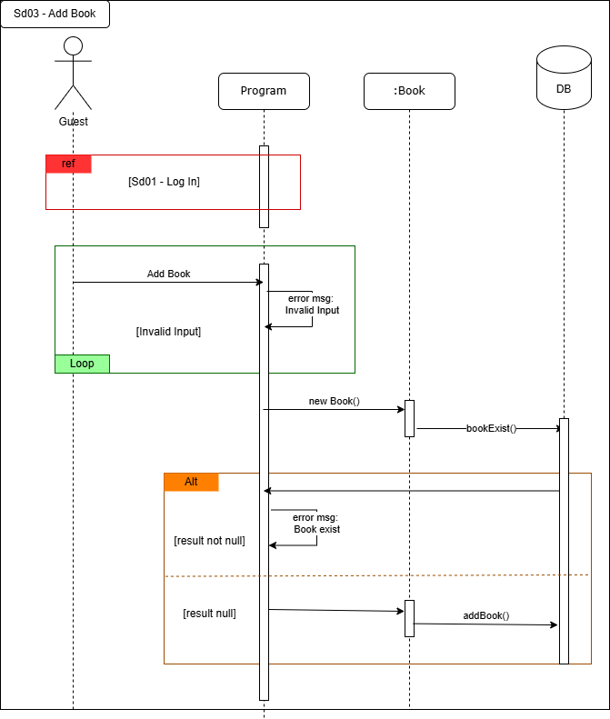
Sequence Diagram

Slide 16
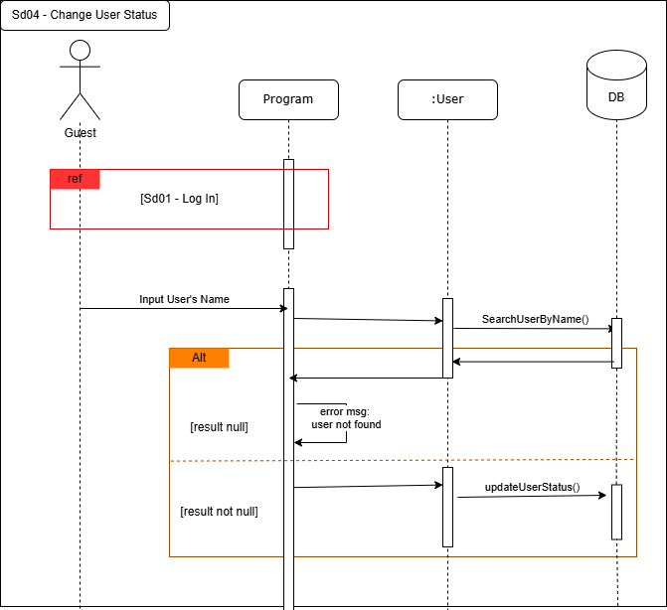
Sequence Diagram

Slide 17
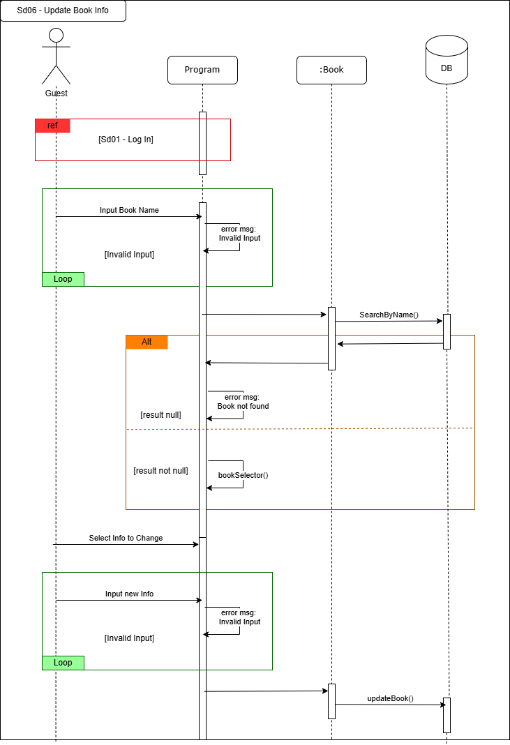
Sequence Diagram

Slide 18
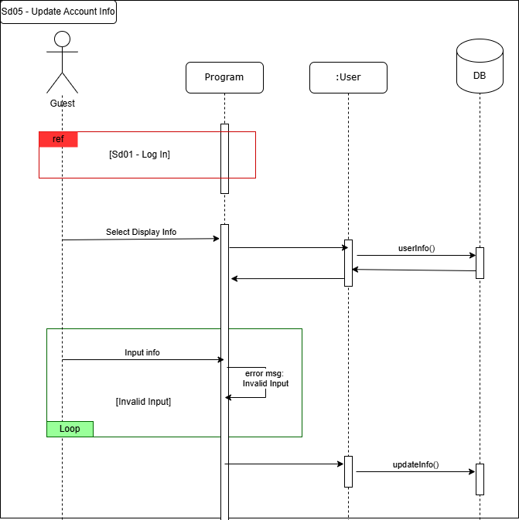
Sequence Diagram

Slide 19
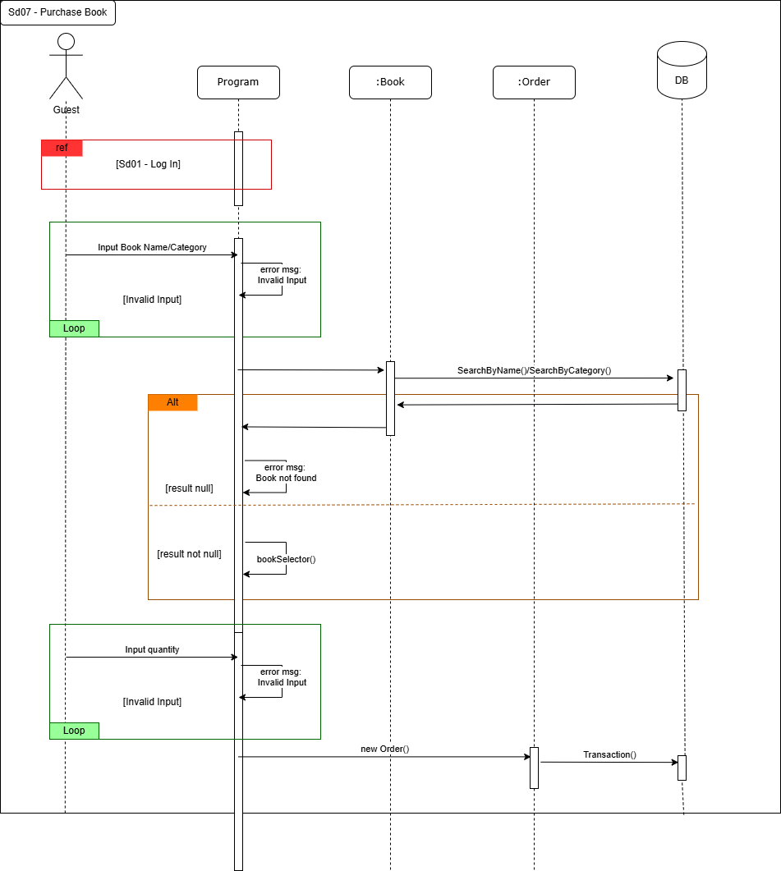
Sequence Diagram

Slide 20
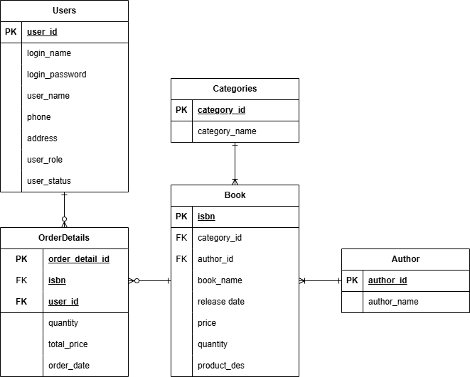
Entity Relationship Diagram

Slide 21
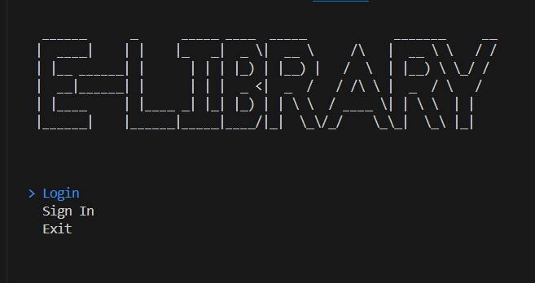
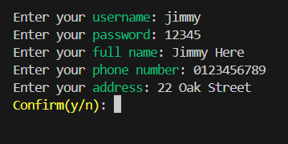
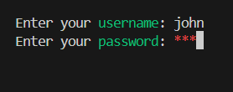
UI Design
Main Menu
Login Option
Sign In Option

Slide 22
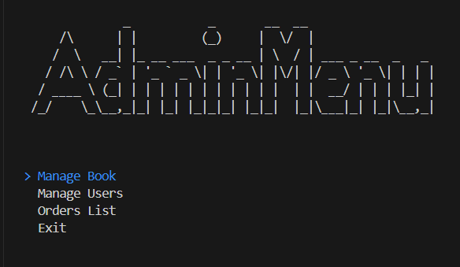
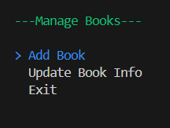
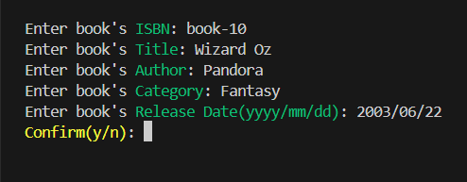
UI Design
Admin Menu
Add Book

Slide 23
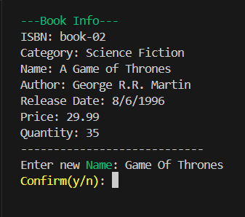
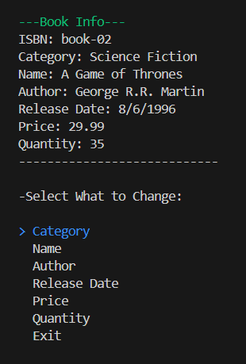
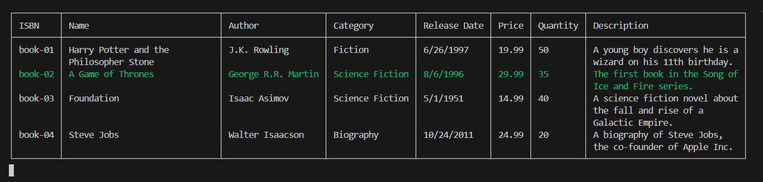
UI Design
Update Book Info

Slide 24
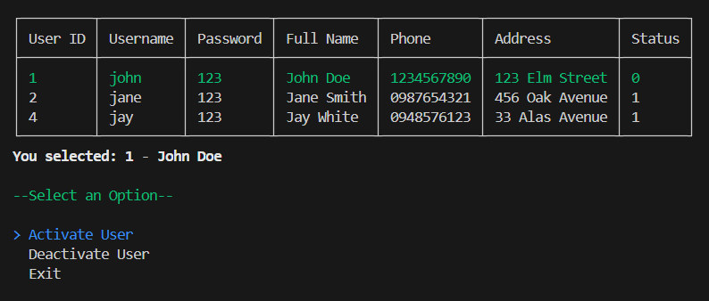
UI Design
Admin Menu
Manage Users

Slide 25
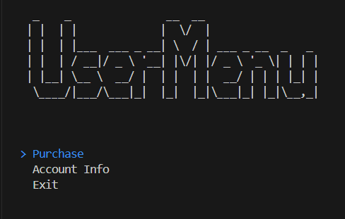
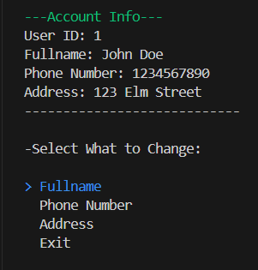
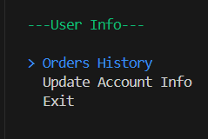
UI Design
User Menu
Update Account Info

Slide 26
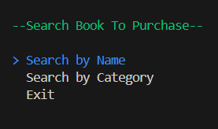
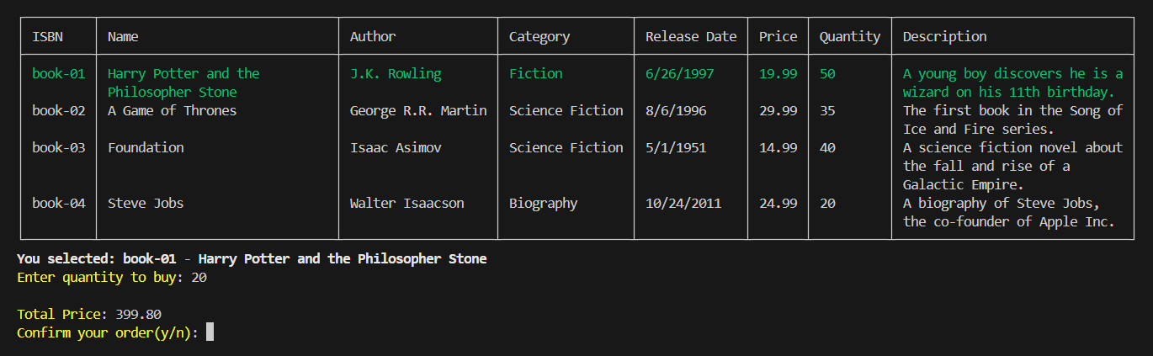
UI Design
Purchase Book

Slide 27
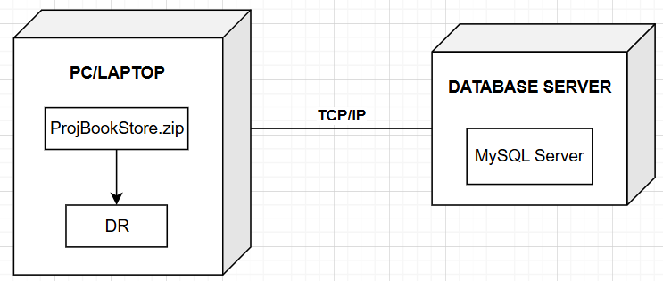
Deployment Diagram

Slide 28
Task Assign (to each team member)
TBN Group | Book Store
No | Task name | Description | Start Date | End Date | Member | Self assessment
1 | Design |  | July 1 | July 7 | Thanh
2 | Code |  | July 1 | July 7 | Nga
3 | Code |  | July 8 | July 20 | Thanh & Nga
4 | Code |  | July 8 | July 15 | Binh
5 | Control |  | July 21 | July 27 | Thanh & Binh
6 | Write Report |  | July 21 | July 27 | Thanh

Slide 29
Experience Learned
1. Technical Skills Development
Programming in C#: Gaining proficiency in C# and its application in developing application.
Database Design and Management: Learning how to design and manage a relational database using MySQL, including writing efficient SQL queries.
Database Connectivity: Understanding how to use MySQL Connector for .NET to establish a connection between the C# application and the MySQL database.
GUI Design: Enhancing skills in designing user-friendly graphical user interfaces that provide a good user experience.
2. Software Development Practices
Modular Design: Learning the importance of modularizing code for better maintainability and scalability.
Error Handling: Implementing robust error handling to improve the reliability of the application.
Code Documentation: Recognizing the value of well-documented code for future maintenance and for other developers who may work on the project.

Slide 30


Slide 31
Q & A

